Slide 1
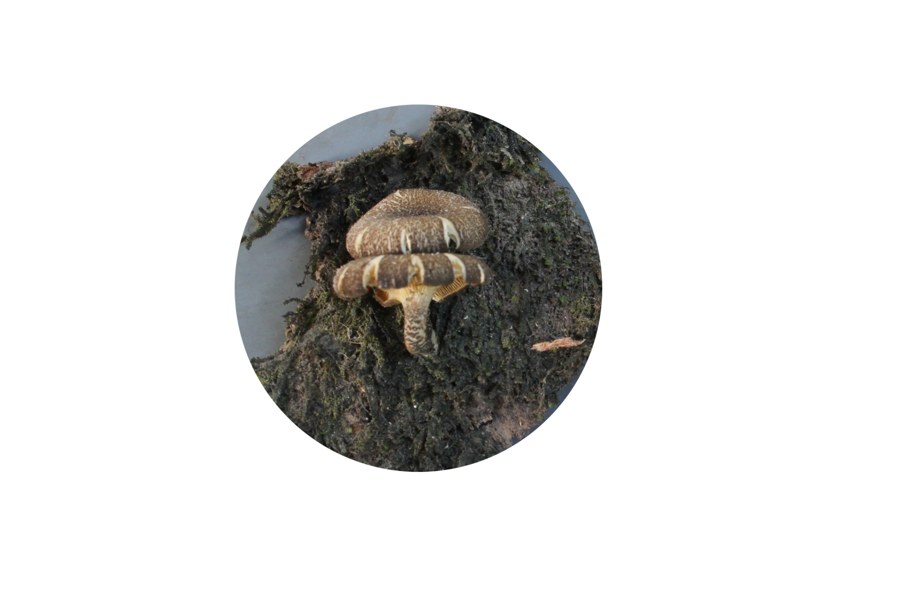
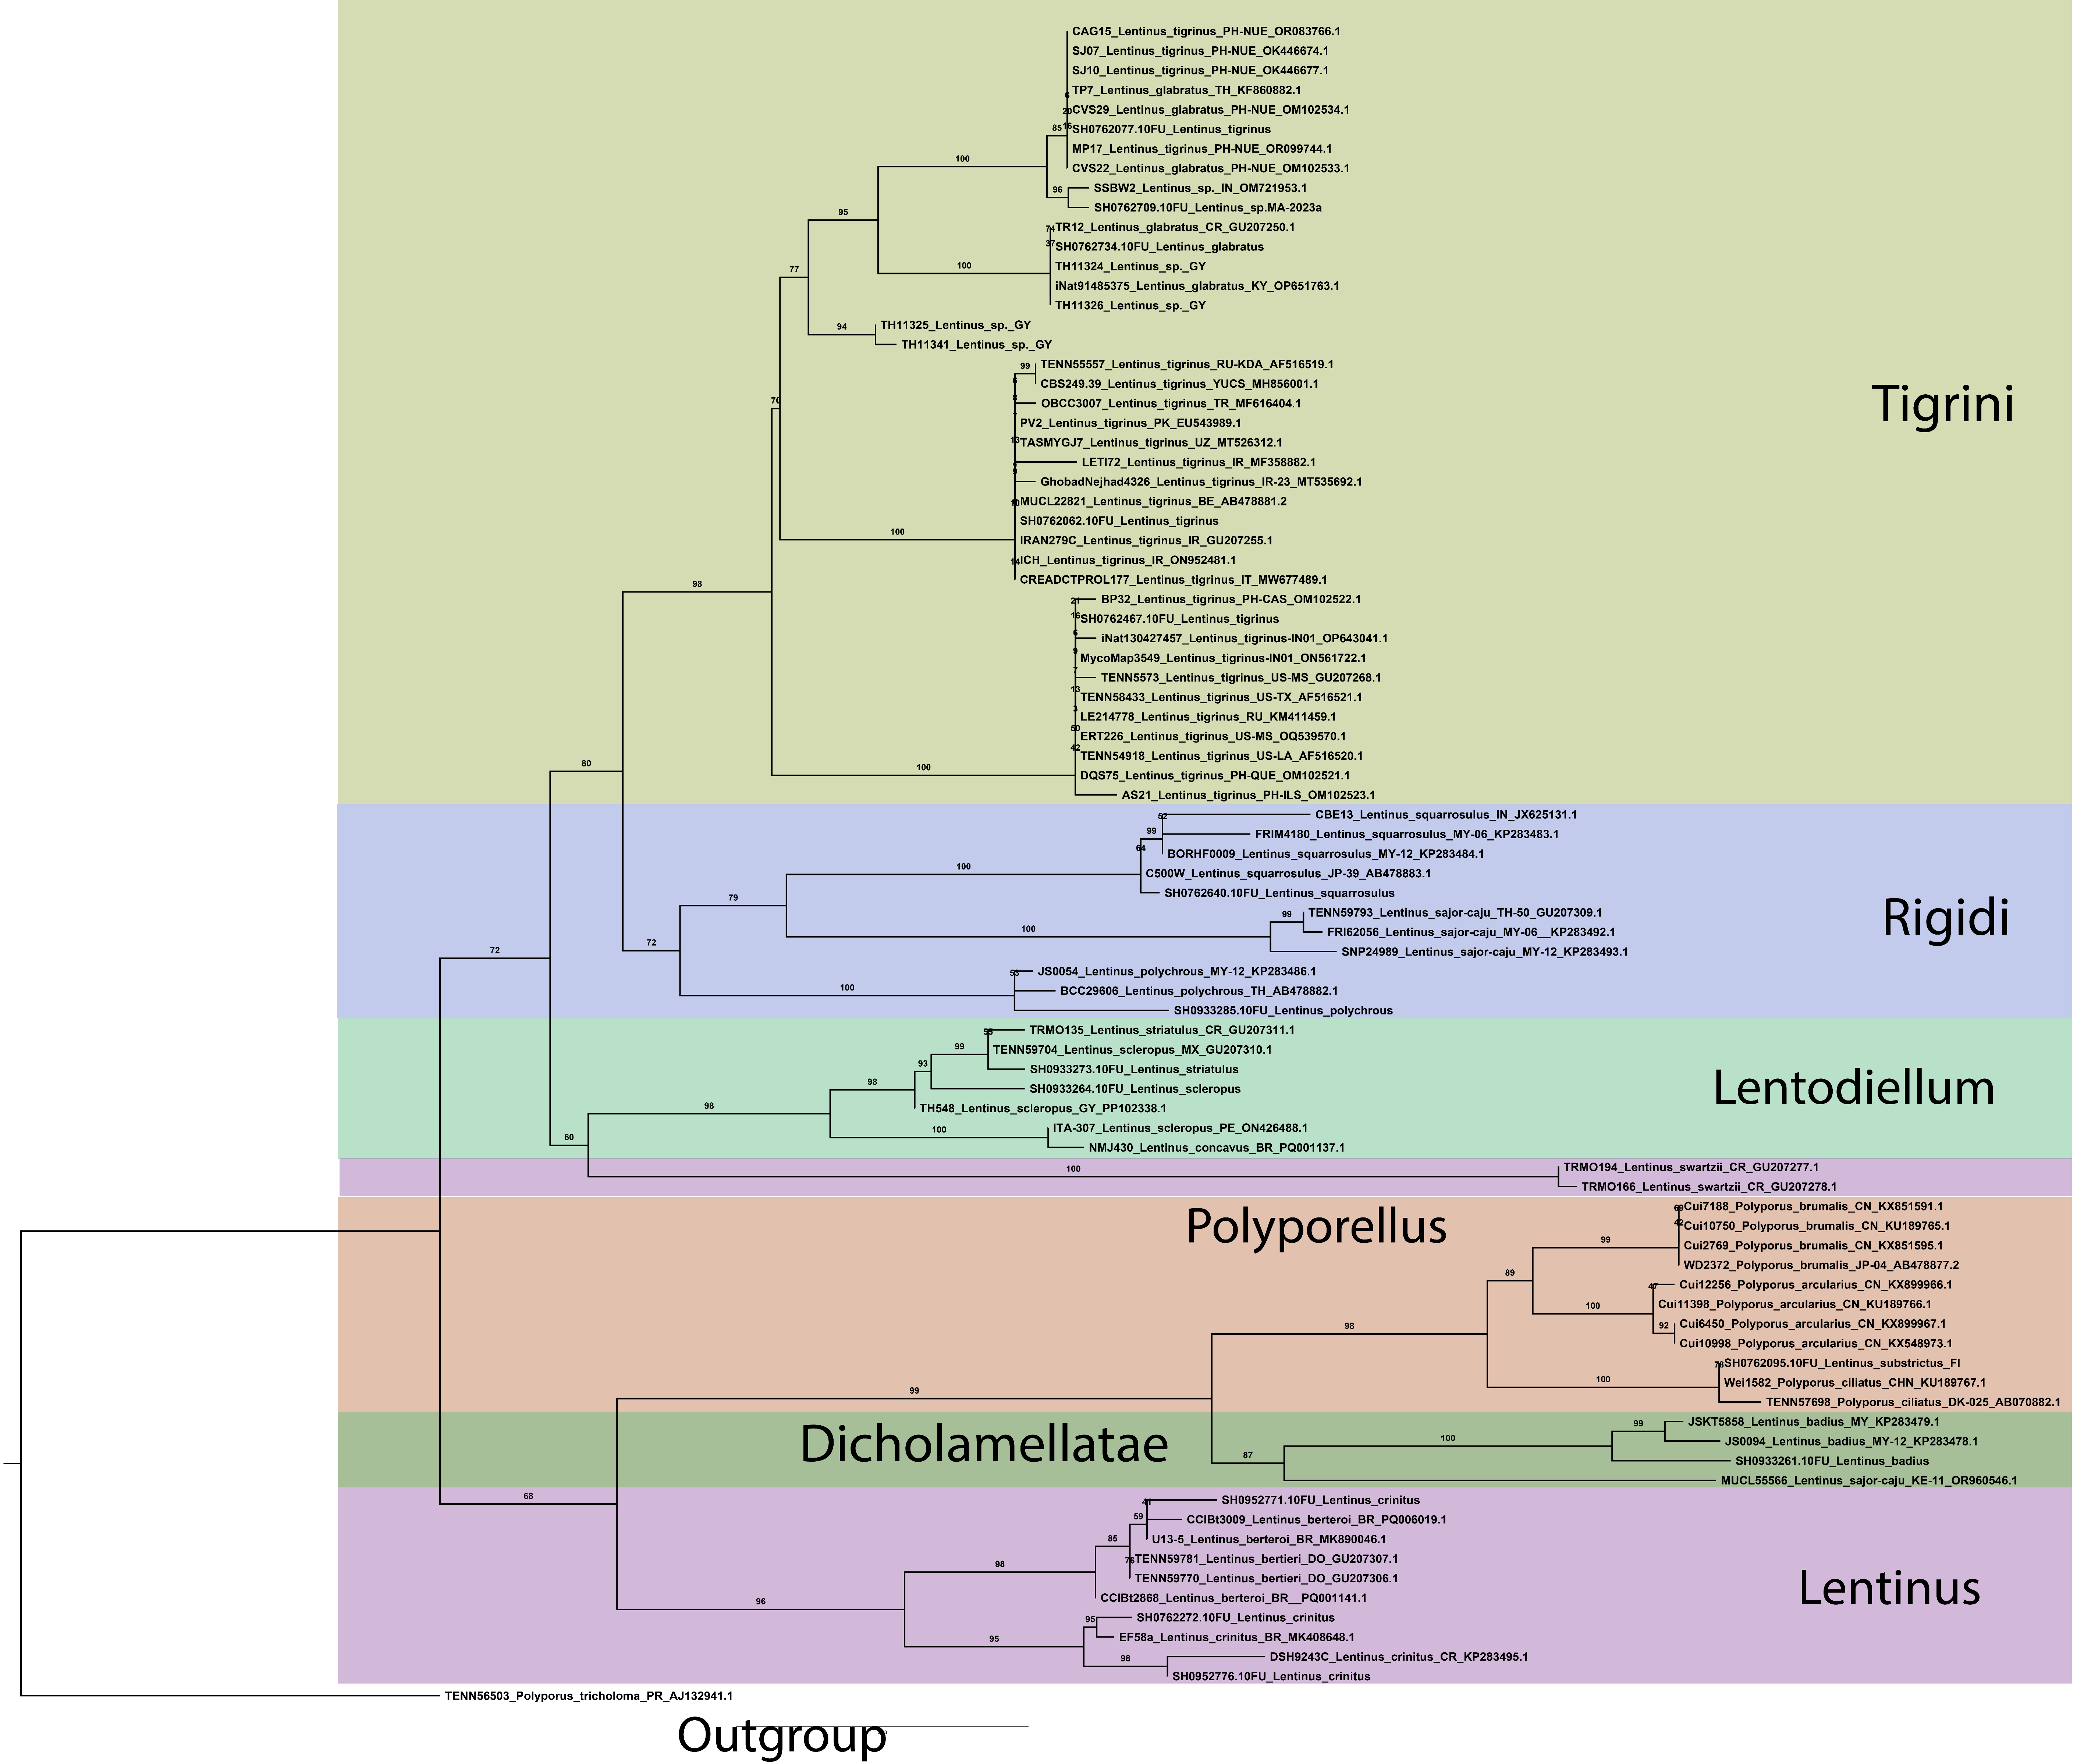
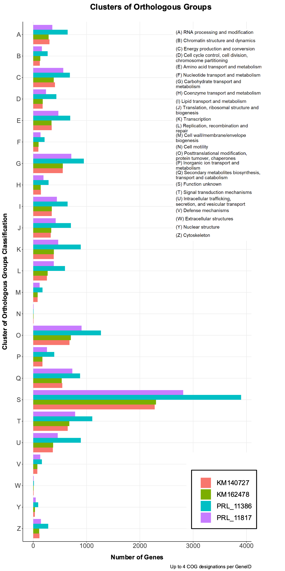
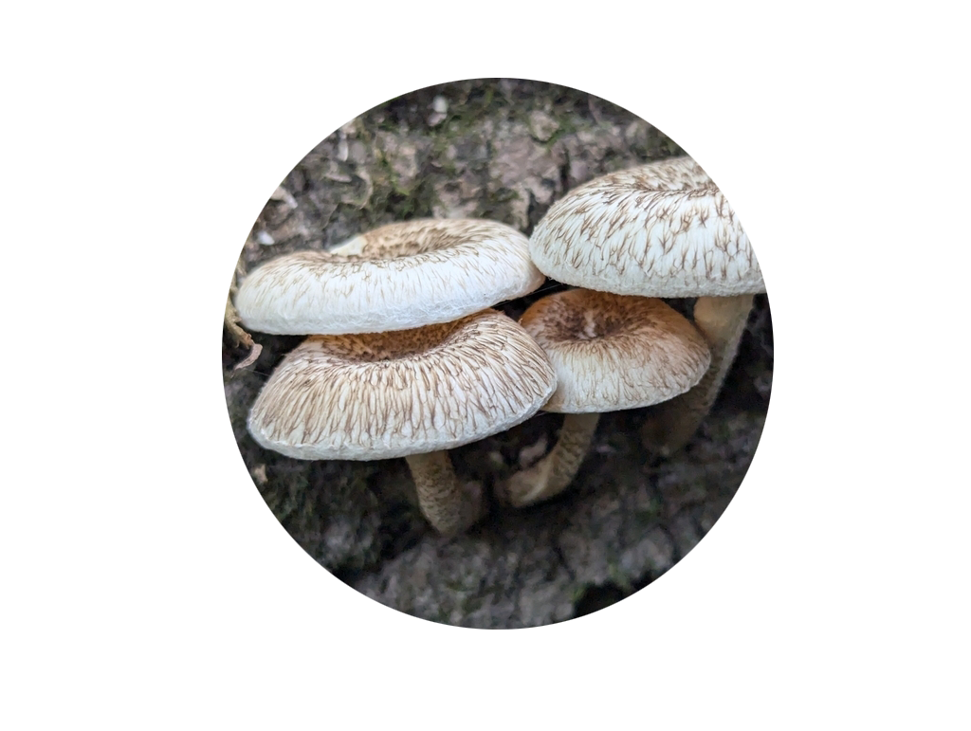
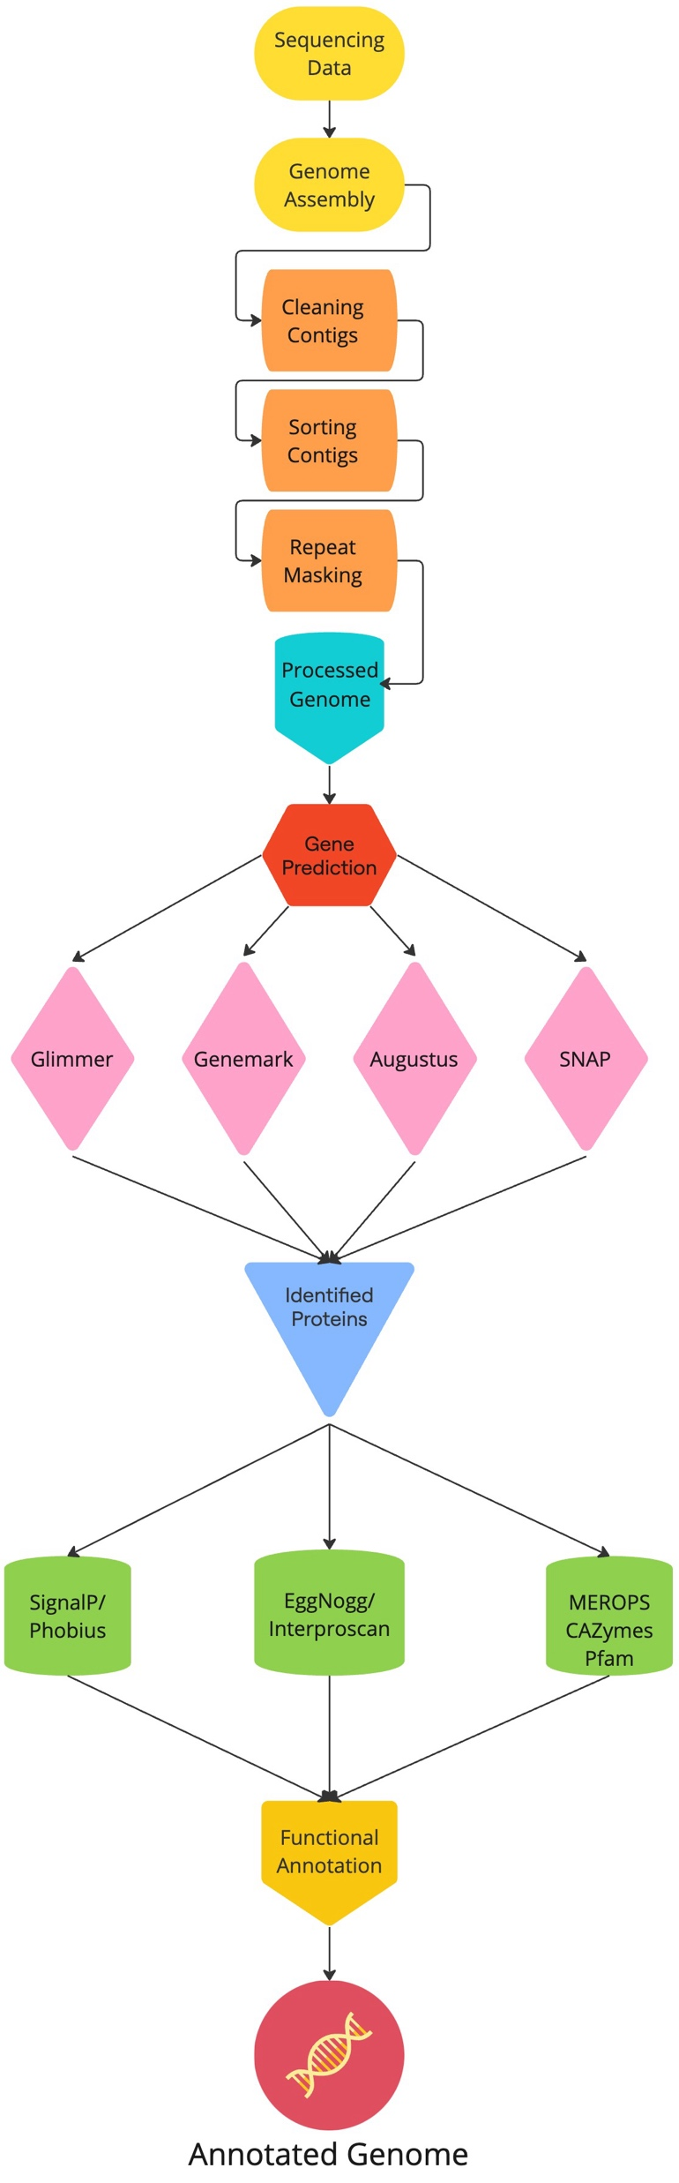
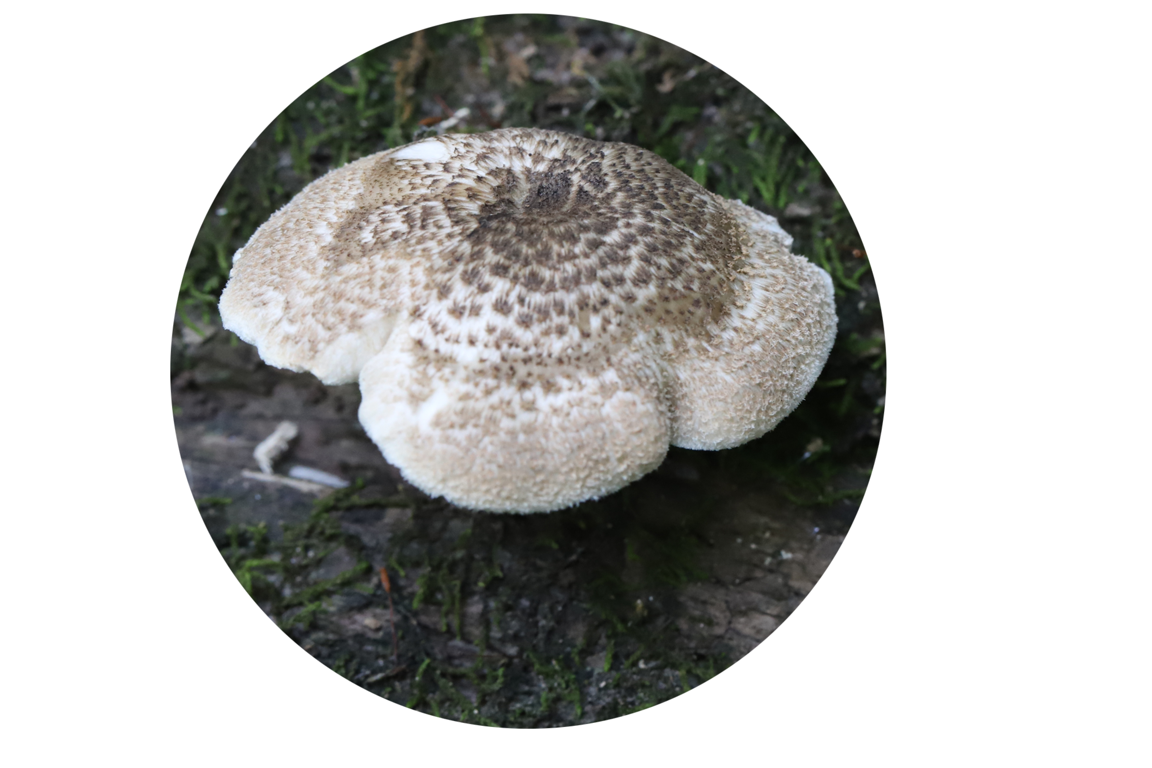
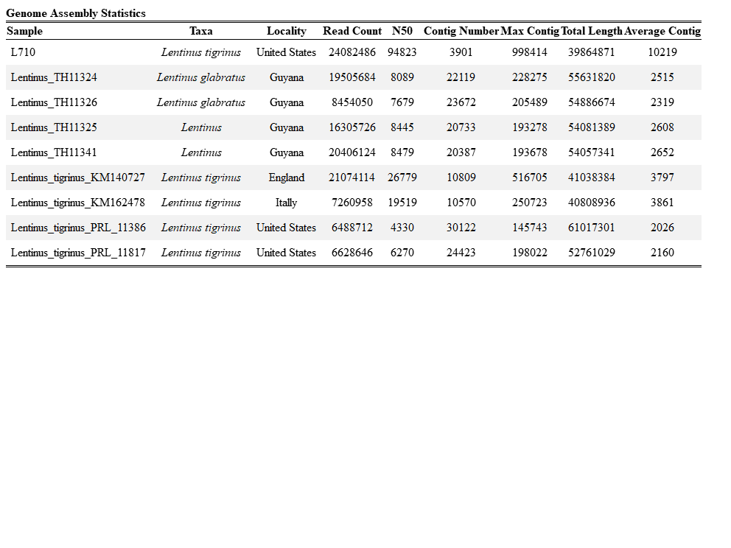
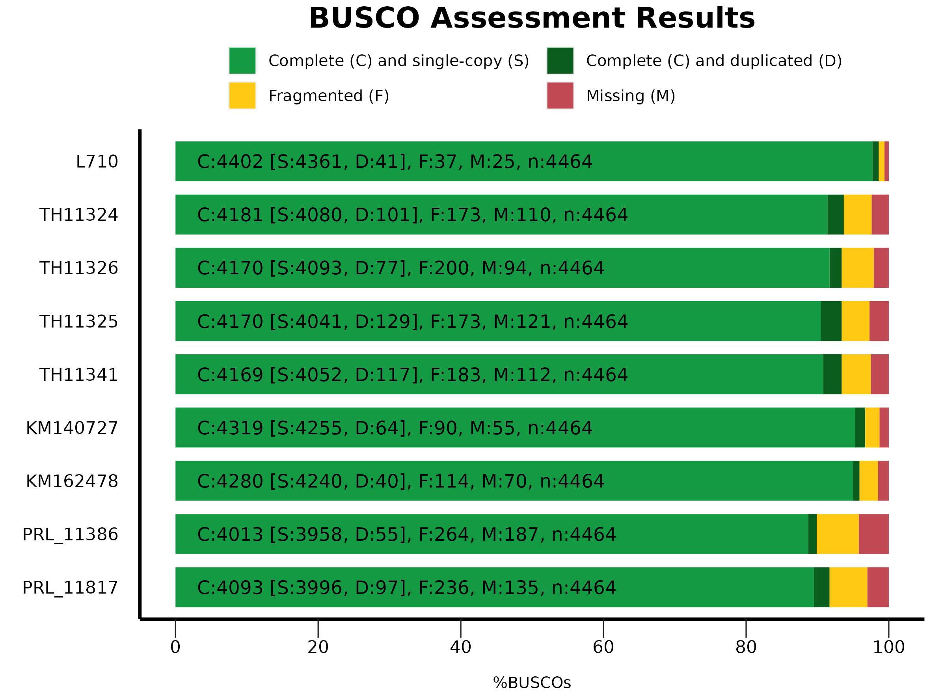





Genome sequencing
and Annotation of Lentinus Section Tigrini
Maximum Likelihood phylogeny
1000 bootstrap replicates
86 of Specimens
Lentinus sp.
Guyana
Annotation
Workflow
Lentinus tigrinus
Global East
Zachary Kratz, Issac Perkis, Alexander James Bradshaw, David S. Hibbett
Clark University, Worcester MA
Lentinus tigrinus
Global West
Introduction
Lentinus tigrinus (Bull.) Fr. is a white rot fungus commonly found across Europe and parts of North America, growing on riverbeds and partially submerged logs. L. tigrinus exhibits an enigmatic phylogenetic divergence between North American and European populations. This study presents preliminary genomic analysis of L. tigrinus from both groups in addition to two other species within the section Tigrini, including a possibly novel species of Lentinus in the section Tigrini from Guyana, offering further insights into the diversity of this clade.
Methodology
Genetic Analysis
Genome sequencing for eight specimens from section Tigrini, two L. tigrinus from the Global West group, two from the Global East group, two L. glabratus, and two possibly novel Lentinus sp. collected from Guyana in South America, was performed using 150x150 Illumina Novoseq6000. Genomes were assembled using MegaHit v1.2.9. We used Funannotate v1.8.17 to perform genome annotations. COGs from the annotations were compared between the cryptic L. tigrinus populations.
Outgroup
Phylogenetic Analysis
Curated ITS dataset from UNITE species hypotheses and GenBank accessions across the genus Lentinus. Dataset was modeled around the genus-level Lentinus analysis performed in Seelan et al. 2015. Alignments were done in MAFFT v7.525; phylogenetic tree was constructed and bootstrapped in IQ-TREE v2.3.6.
Works cited
Li, D., Liu, C.-M., Luo, R., Sadakane, K. & Lam, T.-W. MEGAHIT: an ultra-fast single-node solution for large and complex metagenomics assembly via succinct de Bruijn graph. Bioinformatics 31, 1674–1676 (2015).
Funannotate:
github.com/nextgenusfs/funannotate?tab=readme-ov-file
Abarenkov, K. et al. The UNITE database for molecular identification of fungi – recent updates and future perspectives. New Phytologist 186, 281–285 (2010).
Seelan, J. S. S. et al. Phylogenetic relationships and morphological evolution in Lentinus , Polyporellus and Neofavolus , emphasizing southeastern Asian taxa. Mycologia 107, 460–474 (2015).
Katoh, K. MAFFT: a novel method for rapid multiple sequence alignment based on fast Fourier transform. Nucleic Acids Research 30, 3059–3066 (2002).
Minh, B. Q. et al. IQ-TREE 2: New Models and Efficient Methods for Phylogenetic Inference in the Genomic Era. Molecular Biology and Evolution 37, 1530–1534 (2020).
Acknowledgements
Terry Henkel for providing material
Wyatt Gaswick
Paul Leacock
Royal Botanic Gardens, KEW
The Field Museum of Chicago
#2333266

